Slide 1


Infosecurity Magazine Webinar
Preparing for the Threat of
Data-Stealing Attacks
Sponsored By:
#InfosecWebinar
@InfosecurityMag

Slide 2



Preparing for the Threat of Data-Stealing Attacks
Panel:
Colin West, Sales Engineering Director, EMEA, Tenable
Mark Skilton, Professor of Practice Info Systems & Management, Warwick Business School & PA Consulting
Paul Gribbon, Senior Manager, PwC Cybersecurity
Moderator:
Mike Hine, Deputy Editor, Infosecurity Magazine (@InfosecDepEd)

Slide 3
Poll question: Do you currently run or have plans to run a vulnerability management program?
  Currently running a program
  Looking to improve current program
  Looking to implement a program

Slide 4
Preparing for the Threat of Data-Stealing attacks
Colin West
Systems Engineering Director EMEA
cwest@tenable.com
Twitter - @colinjwest

Slide 5

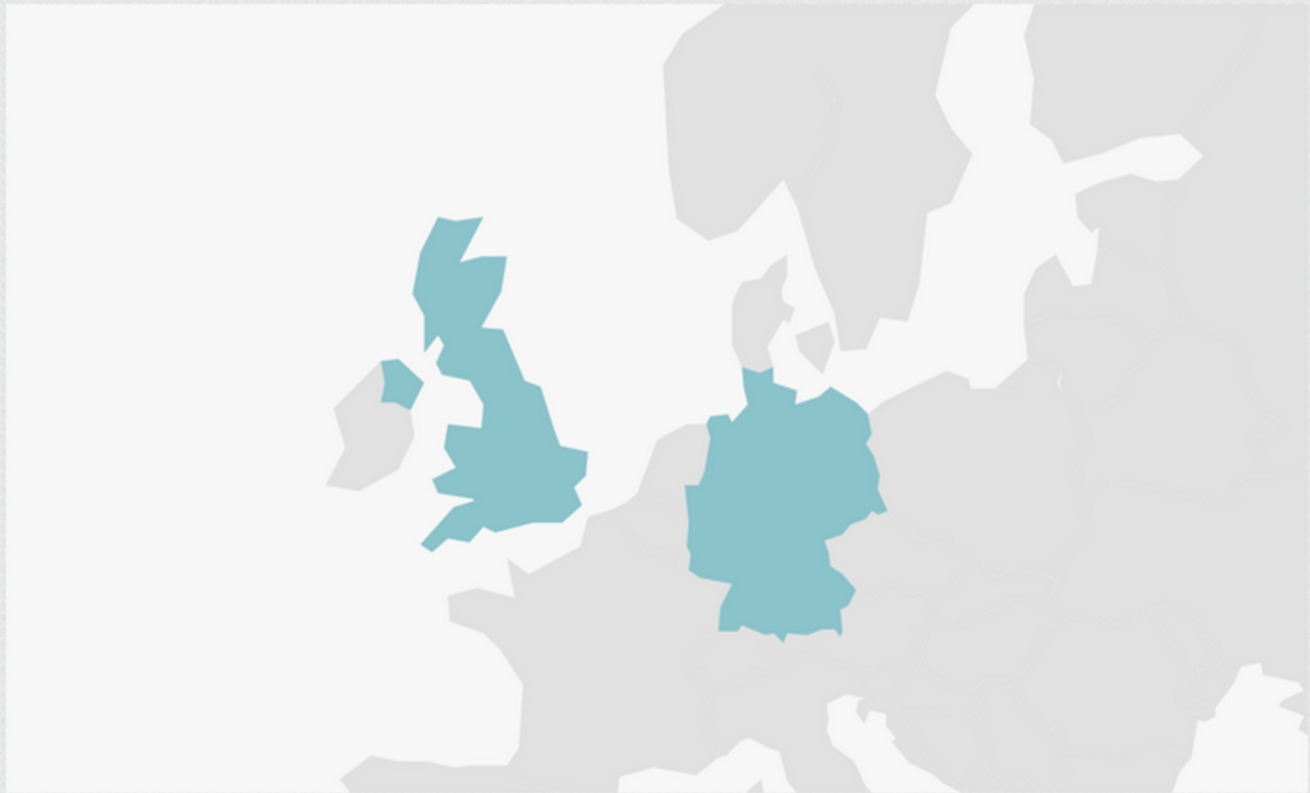
400 Respondents
From the UK and Germany

Slide 6

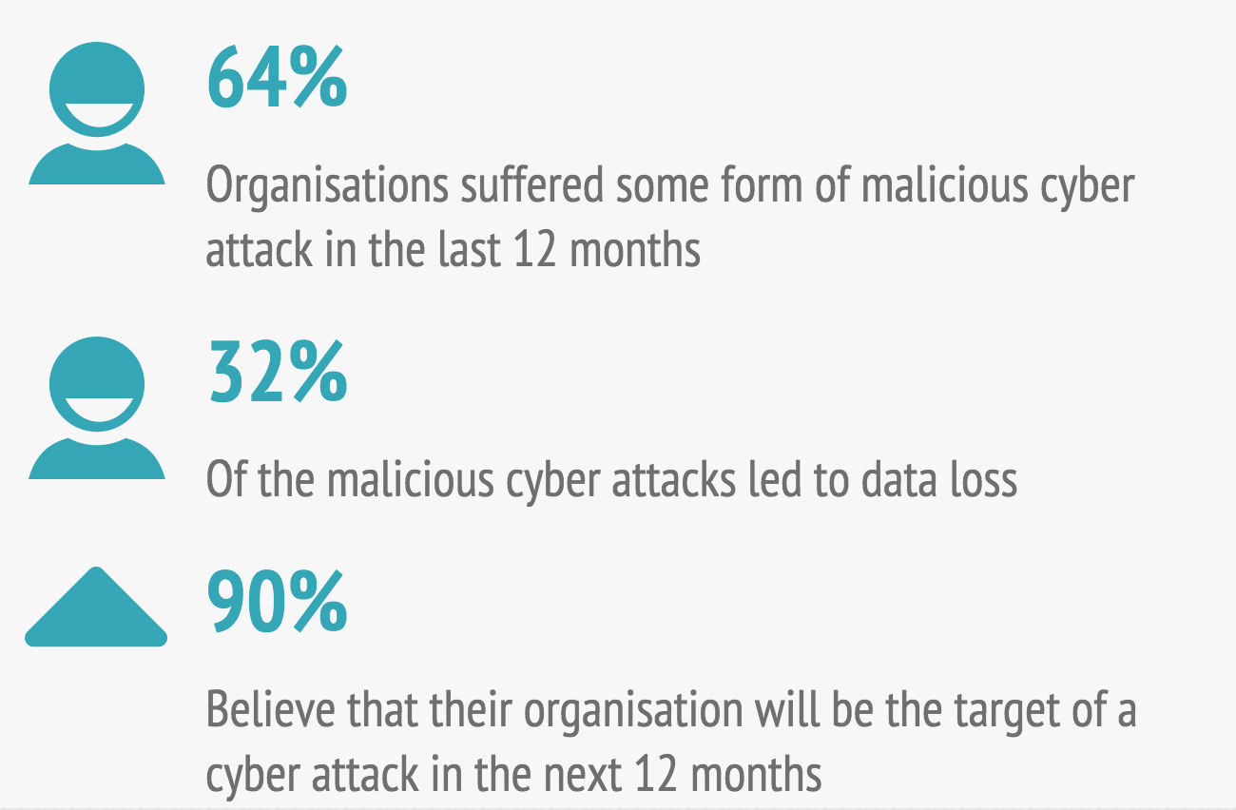
We Asked About Cyber Attacks
Notes:
32% actually lost data from malicious actors

Slide 7

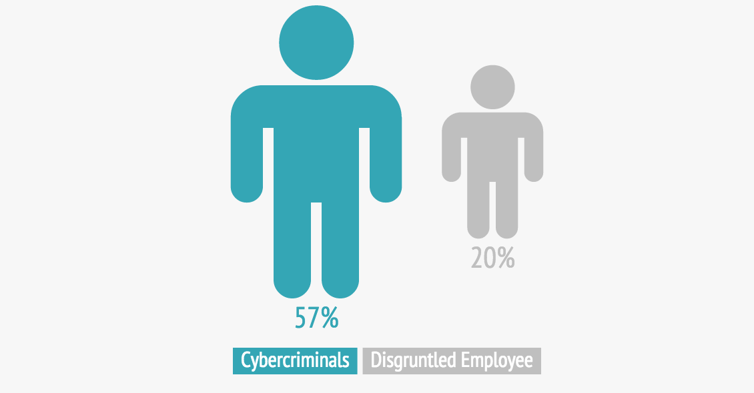
and who were the most likely perpetrators…
Notes:
10% from competitors

Slide 8

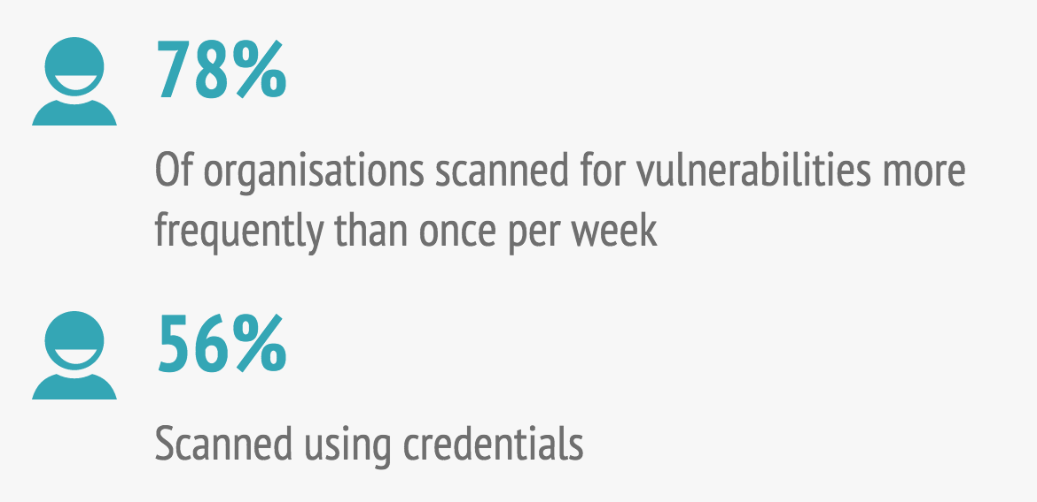
Better than expected visibility through effective vulnerability management

Slide 9







New Threats Discovered Every Day
HEARTBLEED
SHELLSHOCK
VENOM
90M
70%
Millions
network devices vulnerable
of all Internet-facing
machines exposed
Of virtual systems vulnerable because of a flaw in a floppy disk driver
GHOST
DRUPAL
SCADA
WINDOWS
Almost every Linux system vulnerable due to glibc flaw
Almost every installation vulnerable due to flaw
Numerous remote code execution vulnerabilities discovered
Numerous remote code execution vulnerabilities discovered

Slide 10

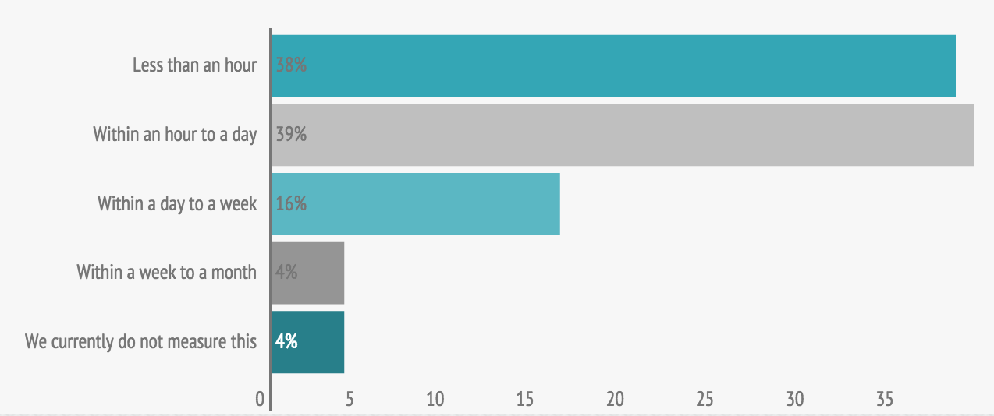
How quickly are patches deployed once approved and tested for a major vulnerability?
Notes:
Responses looked good from those that returned

Slide 11

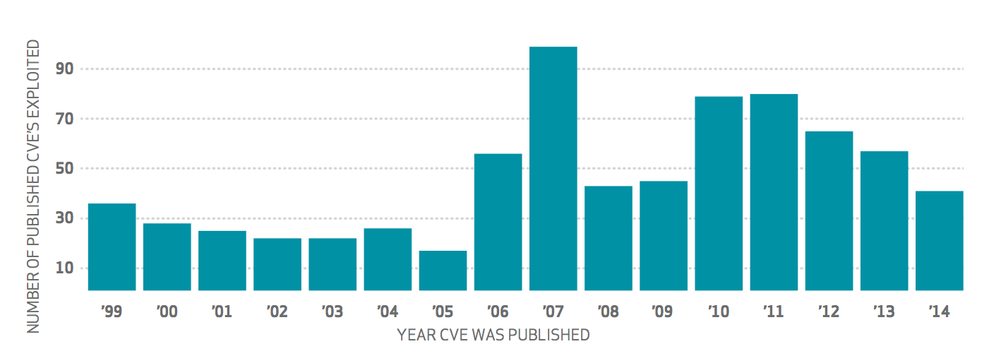
But old vulnerabilities are still used to gain access
Verizon DBIR 2015
“This strongly suggests that a patch deployment strategy focusing on coverage and consistency is far more effective at preventing data breaches than “fire drills” attempting to patch particular systems as soon as patches are released.”
-2015 Verizon Data Breach Investigation Report

Slide 12

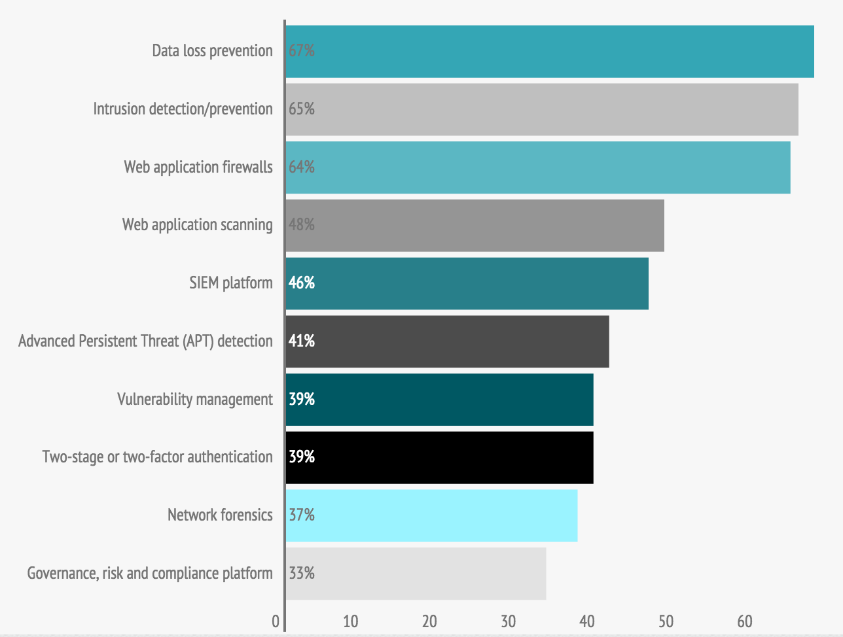
What other controls are deployed?

Slide 13

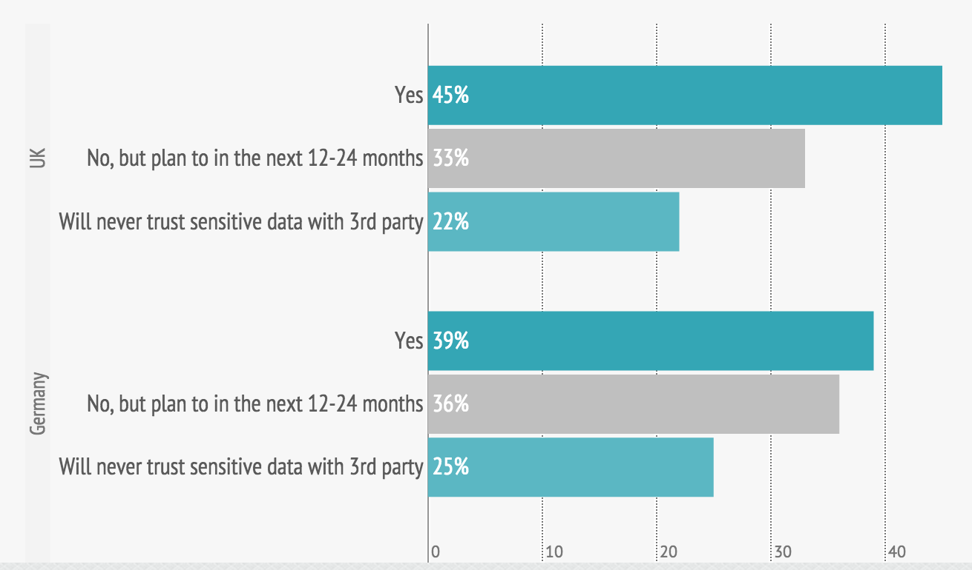
Will organisations store sensitive information in the Cloud?

Slide 14
Colin West
Systems Engineering Director EMEA
cwest@tenable.com
Twitter - @colinjwest

Slide 15
Preparing for the Threat of Data-Stealing Attacks
Panel:
Colin West, Sales Engineering Director, EMEA, Tenable
Mark Skilton, Professor of Practice Info Systems & Management, Warwick Business School & PA Consulting
Paul Gribbon, Senior Manager, PwC Cybersecurity
Moderator:
Mike Hine, Deputy Editor, Infosecurity Magazine (@InfosecDepEd)

Slide 16
Poll question: Is there a requirement to report your security posture to senior management/board?
  Yes, and I do this well
  Yes, but I have difficulty conveying the message in a language they understand
  No, but I do provide basic metrics for accountability
  No requirement

Slide 17



Preparing for the threat of Data Stealing Attacks
Prof. Mark Skilton
Digital Business - PA Consulting
Innovation Lab – PA Consulting
Professor of Practice, Information Systems Management, Warwick Business School
@mskilton mark.skilton@PAConsulting.com 07808039240
3pm June 18 2015
Webinar

Slide 18




What are the Threats of Data Stealing ?
“SMASH & GRAB”
POLITICAL, CAUSE
NEW METHODS OF ACCESS
AND PREVASIVENESS
STEALTH
“WAREFARE
AND CRIMIAL ACTIVITY”
IN PLAIN SIGHT
“OPEN DATA & COMMERCIAL
DATA RESELLING
“UNDER THE RADAR
INTELLIGENCE & CRIMINAL
ACTIVITY”
Consumer Groups Back Out of Federal Talks on Face Recognition – NYT Bits
June 2015
Hackers in China suspected over US breach Gov Data –
FT June 2015
Sony – movie and Private Data Theft, North Korean influence..
Anthem – 80 million US medical insurance records stolen
Researchers Hack Into Michigan’s Traffic Lights - MIT
Russian banks Malware “attack” $1 Billion stolen incrementally
March 2015
FBI: Hacker claimed to have taken over flight's engine controls – CNN May 2015

Slide 19
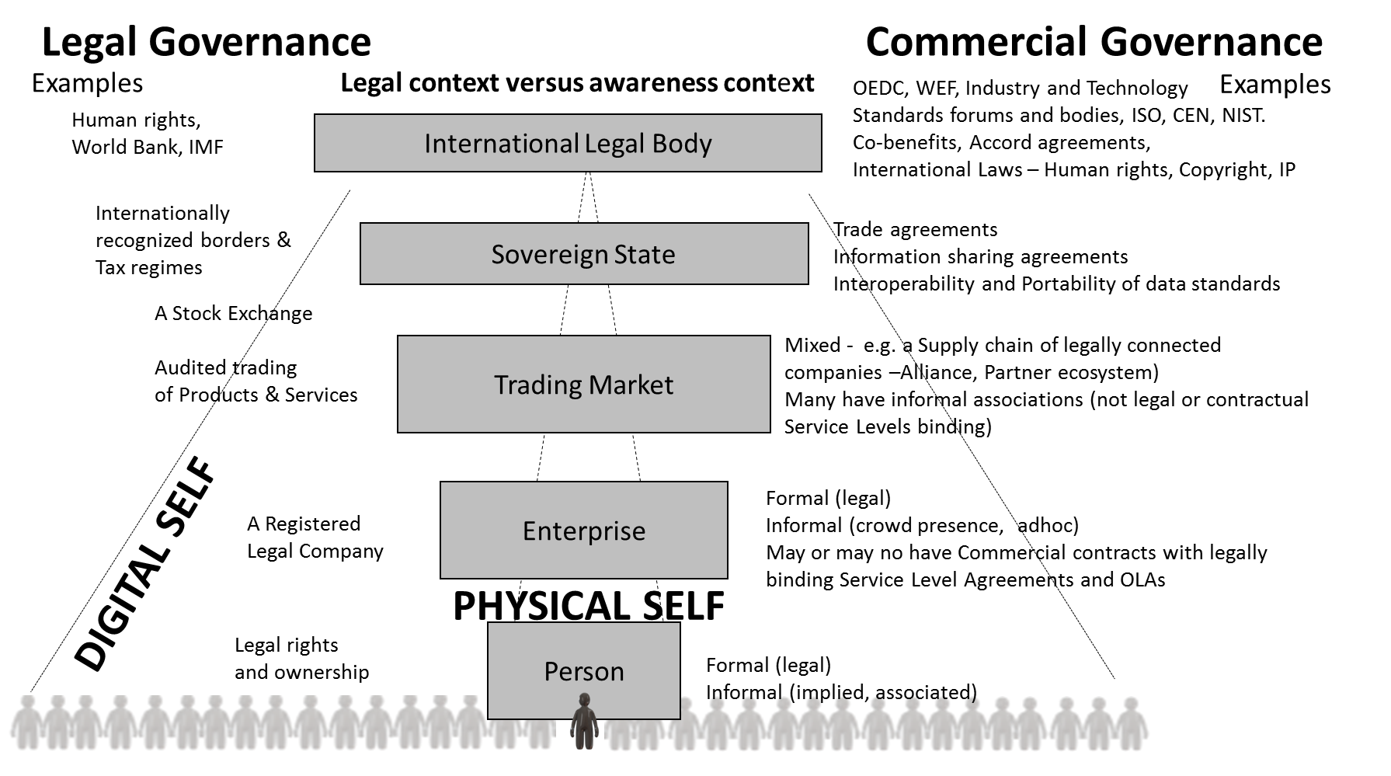
It’s getting harder to manage the Legal jurisdiction
DIGITAL GOVERNANCE ?

Slide 20



Cyber Security – Cyber governance
PRIVACY, CONFIDENTIALITY, (TECHNICAL) SECURITY , TRUST
INCREASED COMPLEXITY
FINER GRAINED
MONTORING
ADVANCED RESPONSE
THREAT MANAGEMENT
ZERO DAY ATTACKS
NEW THREAT VECTORS
NEW ASSET TARGETS (MEDICAL, FINANCIAL..
NEW LEVELS OF
CYBER GOVERNANCE

Slide 21
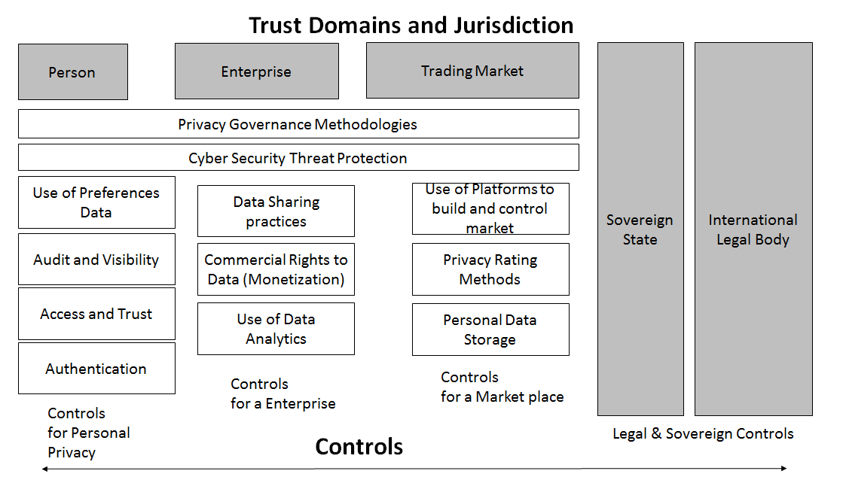
We need a Digital Trust Ecosystem approach
AWARENESS
&
CONTROL

Slide 22
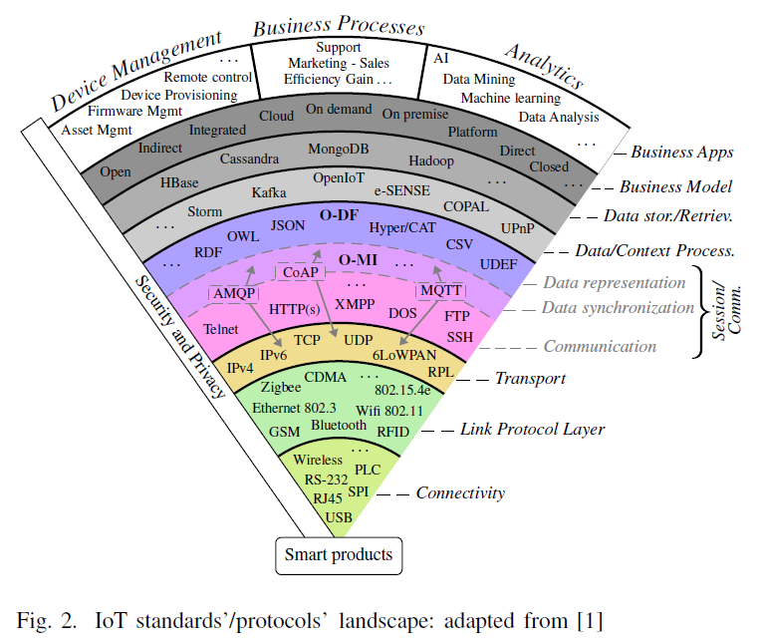
A major problem is in managing so many the Standards and protocols
- the breaches often exploit vulnerabilities
Source: “Opportunity to Leverage Information-as-an-Asset in the IoT – The road ahead” Sylvain Kubler, Min-Jung Yoo, Cyril Cassagnes, Kary Framling, Dimitris Kiritsis, Mark Skilton, FiCloud Rome 2015 IEEE Conference paper
But The
INTERNET
OF THINGS and
the DIGITAL ENTERPRISE
and the
DIGITAL ECONOMY
is Growing
Original Source: O. Vermesan and P. Friess, Internet of Things – From Research and Innovation to Market Deployment. River Publishers, 2014.

Slide 23
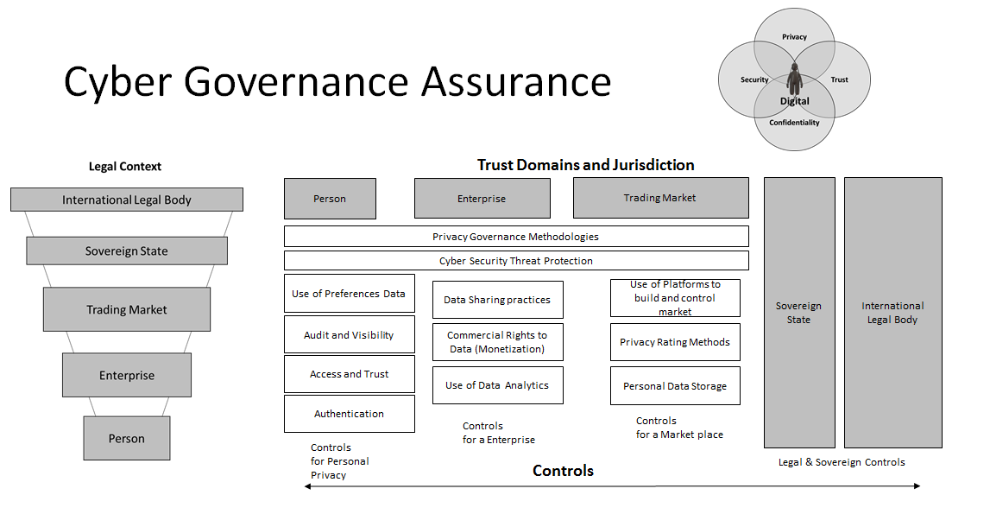
CONCLUSIONS – Need to move towards a Comprehensive Cyber Assurance framework
1
Better perimeter and environment awareness - The length of time typically have access to victims’ environments

Slide 24
CONCLUSIONS – Need to move towards a Comprehensive Cyber Assurance framework
2
New finer grained usage and access - Third party compromises – how many companies are affected and how to detect

Slide 25
CONCLUSIONS – Need to move towards a Comprehensive Cyber Assurance framework
3
Consortiums – shared cyber intelligence - Multi-model- The complexity of attribution as the lines blur between tactics used by cyber-criminals and nation-state actors

Slide 26
CONCLUSIONS – Need to move towards a Comprehensive Cyber Assurance framework
4
Need new legal and technical capabilities
  The stealthy new tactics cyber-criminals deploy in order to move laterally and maintain persistence in victim environments.

Slide 27
CONCLUSIONS – Need to move towards a Comprehensive Cyber Assurance framework
5
Need a New DIGITAL
IDENTITY SELF
FRAMEWORK –
currently fragmented

Slide 28

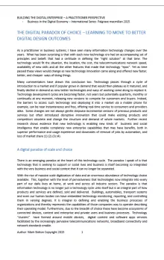
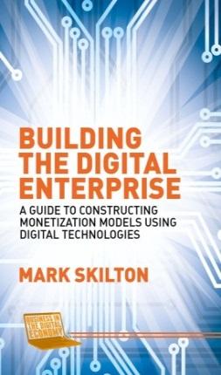
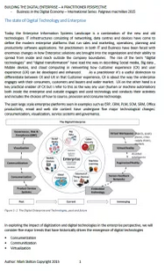
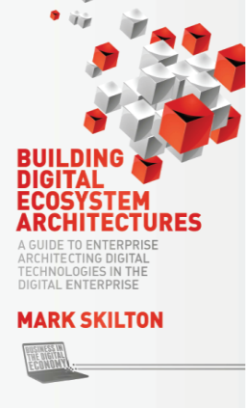
International Publications Impact - and suggested further reading
Suggested further reading
The Paradox of choice – learning to move to better digital design outcomes – Paper 1
This paper explores the move from business to digital business models.
Publication:
21 Aug 2015
Palgrave macmillan International
“Business in the Digital Economy”
Professional International Series
Publication
27 Oct 2015
The state of Digital Technology and Enterprise – Paper 2
This paper examines the types of digital technology functionality trends and their impact on enterprise solution design.
Notes:
http://building-the-digital-enterprise.com/wp-content/uploads/2015/03/The-Paradox-of-choice-learning-to-move-to-better-digital-design-outcomes-Paper-1.pdf
http://building-the-digital-enterprise.com/wp-content/uploads/2015/03/The-state-of-Digital-Technology-and-Enterprise-Paper-2.pdf

Slide 29

Thank you
Prof. Mark Skilton, Professor of Practice, Information Systems Management Warwick Business School
Digital Expert, PA Consulting
Mobile : 07808039240
An accomplished business technology leader who has worked for many fortune 500 companies in over 20 countries, across private and public industry sectors. Mark is currently a Digital Expert at PA Consulting with experience in leadership innovation and strategy for digital platforms, big data, cloud computing, interoperability, metrics monetization and cyber security. He has worked at board level in strategic vision and corporate planning for Business and digital media solutions in companies including media, telecoms, aerospace, retail , travel , city, central and local government, logistics. Healthcare and financial services.
Mark is recognized international thought leader, speaking at internationally including the EU Commission and several Industry conferences and live TV and Radio and digital media including BBC, Sky, FT, BBC.com and widely syndicated globally. He is the author of two books on building Digital Enterprise for Palgrave macmillan Digital Economy series and a co collaborator on several International Standards with ISO and The Open group. He is also Professor of Practice in Information Systems Management and Innovation at Warwick Business School.
Mark.Skilton@PAConsulting.com
https://twitter.com/mskilton
https://www.linkedin.com/profile/public-profile-settings?trk=prof-edit-edit-public_profile
http://www.markskilton.com personal blog

Slide 30
Preparing for the Threat of Data-Stealing Attacks
Panel:
Colin West, Sales Engineering Director, EMEA, Tenable
Mark Skilton, Professor of Practice Info Systems & Management, Warwick Business School & PA Consulting
Paul Gribbon, Senior Manager, PwC Cybersecurity
Moderator:
Mike Hine, Deputy Editor, Infosecurity Magazine (@InfosecDepEd)

Slide 31
Poll question: Do you feel that your goals are in line with the business goals?
  No, I’m just fighting fires!
  I don’t know what the business goals are or how they relate to security
  We are included in project planning within the business occasionally
  A representative of the security team is included in nearly all projects

Slide 32
Information Security Breaches Survey
2015 Results
June 2015

Slide 33
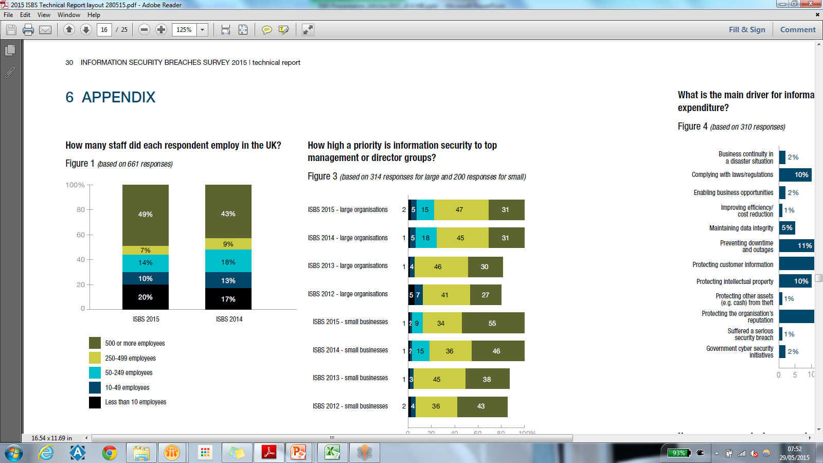

Source of the survey data
How many staff did each respondent employ in the UK?
Figure 1 (based on 661 responses)

Slide 34
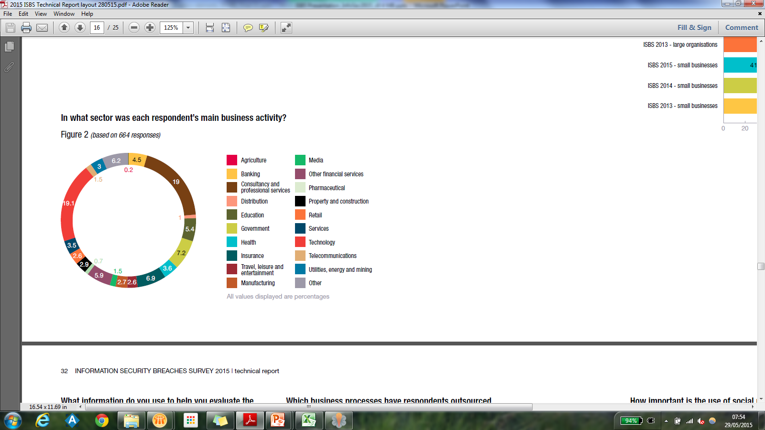
Source of the survey data
In what sector was each respondent’s main business activity?
Figure 2 (based on 664 responses)

Slide 35



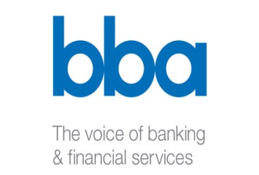




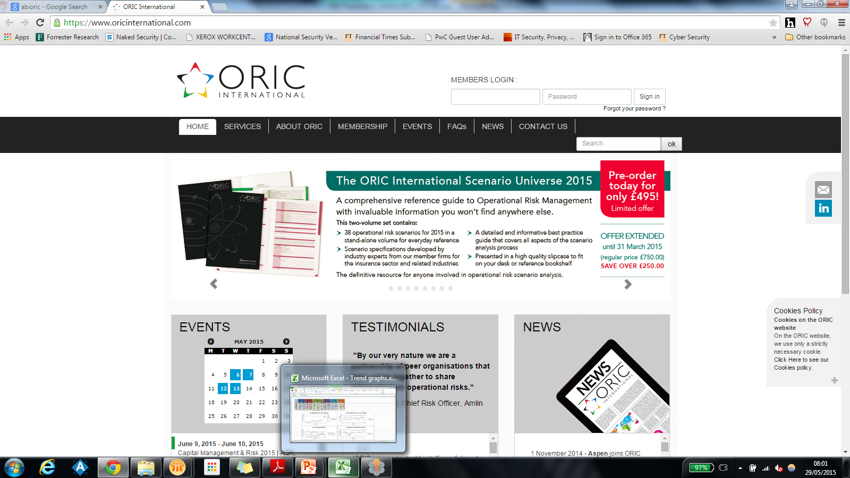



Special thanks
Thank you to all the organisations who supported this survey:

Slide 36
Number of breaches increasing…
Respondents who had a security breach
59% of respondents expect more breaches next year…
90%
74%
Large organisations (81% last year)
Small organisations (60% last year)

Slide 37
… as is the impact of breaches
£1.5m - £3.1m | Average cost to a large organisation of its worst security breach of the year (up from £600,000 to £1.15m a year ago)
£75k - 311k | Average cost to a small business of its worst security breach of the year (up from £65,000 to £115,000 a year ago)
Billions | Estimated total cost to UK plc
11% of respondents (up from 10% last year) changed the way their business operates as the result of their worst breach.

Slide 38
The Human Factor
Organisations that suffered a staff related incident
50% of the worst breaches of the year were caused by inadvertent human error.
75%
31%
Large organisations (58% a year ago)
Small businesses (22% a year ago)

Slide 39




The Human Factor
Contributory factors in single worst breach?
72% of large organisations and
63% of small businesses have an ongoing awareness and education programme.
However 1 in 10 large organisations have no formal security awareness or education programme.
48% inadvertent human error
33% lack of staff awareness
18% deliberate misuse of systems by staff
17% weaknesses in vetting

Slide 40


Reputation a key concern…
49% of respondents (30% last year) stated that reputational damage defined their worst single incident of the year.
35% of large organisations and 13% of small businesses stated that their most serious incident of the year resulted in extensive adverse or some adverse media coverage.
43% of large organisations and 75% of small businesses kept knowledge of their worst incident inside the organisation.

Slide 41
What is the main driver for information security?
%

Slide 42
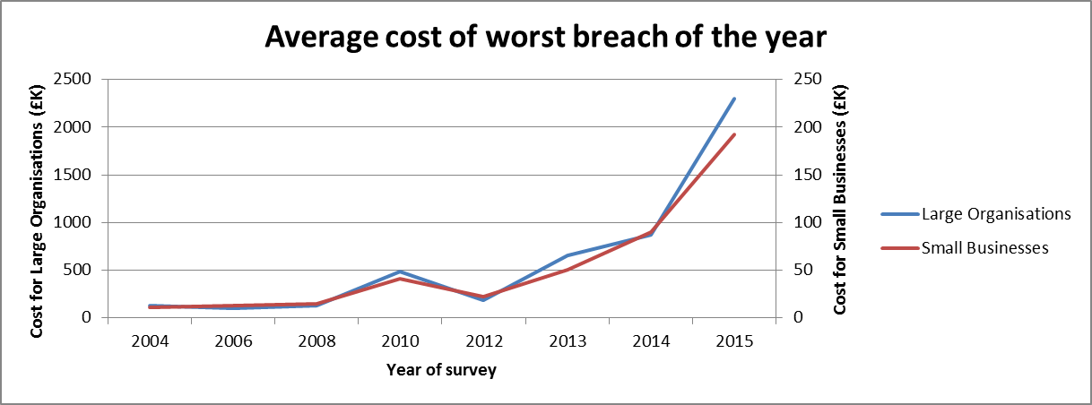
Average cost of the worst breach

Slide 43
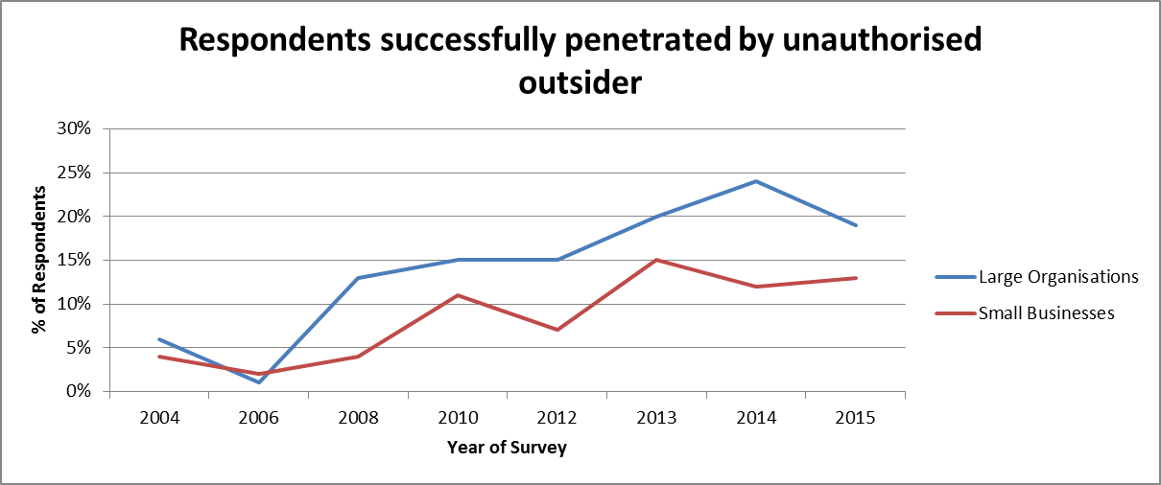
Respondents successfully penetrated by an outsider

Slide 44
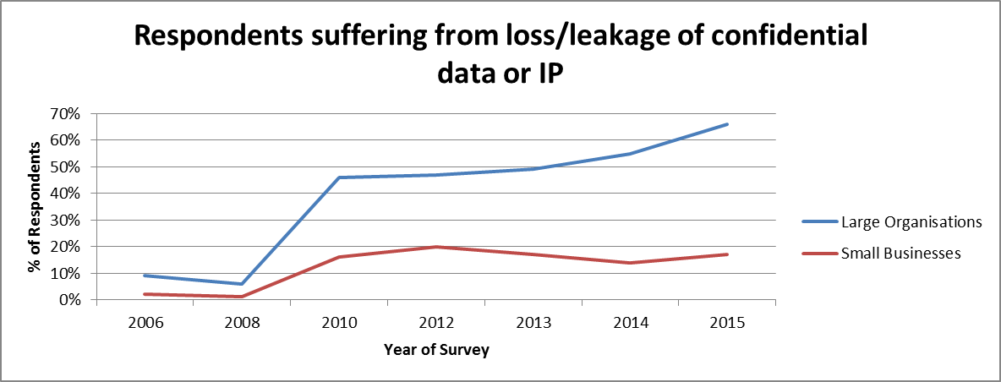
Respondents suffering loss/leakage of confidential data

Slide 45
Summary – Key Observations
1. The number of security breaches has increased, the scale and cost has nearly doubled.
2. Not as many organisations increased their spending in information security, and fewer organisations than in previous years expect to spend more in the future.
3. Nearly 9 out of 10 large organisations surveyed now suffer some form of security breach – suggesting that these incidents are now a near certainty. Businesses should ensure they are managing the risk accordingly.
4. Despite the increase in staff awareness training, people are as likely to cause a breach as viruses and other types of malicious software.
5. When looking at drivers for information security expenditure, ‘Protecting customer information’ and ‘Protecting the organisation’s reputation’ account for over half of the responses.
6. The trend in outsourcing certain security functions and the use of ‘Cloud computing and storage’ continue to rise.

Slide 46
Resources
Full survey report is available from:
Department for Business, Innovation and Skills - www.gov.uk/bis
PricewaterhouseCoopers LLP - http://www.pwc.co.uk/audit-assurance/publications/
Infosecurity Europe – www.infosecurityeurope.com
Explore the data here: https://dm.pwc.com/HMG2015BreachesSurvey

Slide 47
Preparing for the Threat of
Data-Stealing Attacks
Sponsored By:
Q&A
Mark Skilton, Warwick
Business School/ PA Consulting
Paul Gribbon,
PwC Cybersecurity
Got a question for the panel? Submit anonymously through the Ask a Question tab at the top of the slideshow area
Colin West, Tenable

Slide 48
Thank you for attending
Upcoming webinars:
18th June, ‘Finding Privacy and Trust in the Cloud’
19th June, ‘Creating a Company-Wide Information Security Culture’
25th June, ‘Meeting the New Challenges of Enterprise Security’
2nd July, ‘Protecting Data Across Cloud Applications: the Hidden Challenge’
7th July, ‘Secure Your Mobile Workforce, Improve Productivity’
July 9th, How Outsiders Become Insiders: Understanding and Combating Today's Threats
https://www.infosecurity-magazine.com/webinars/

